Slide 1
Autism myths and me
David Hopkins, HMRC Digital
david.hopkins@hmrc.gov.uk

Slide 2
Everyone’s a little bit autistic

Slide 3
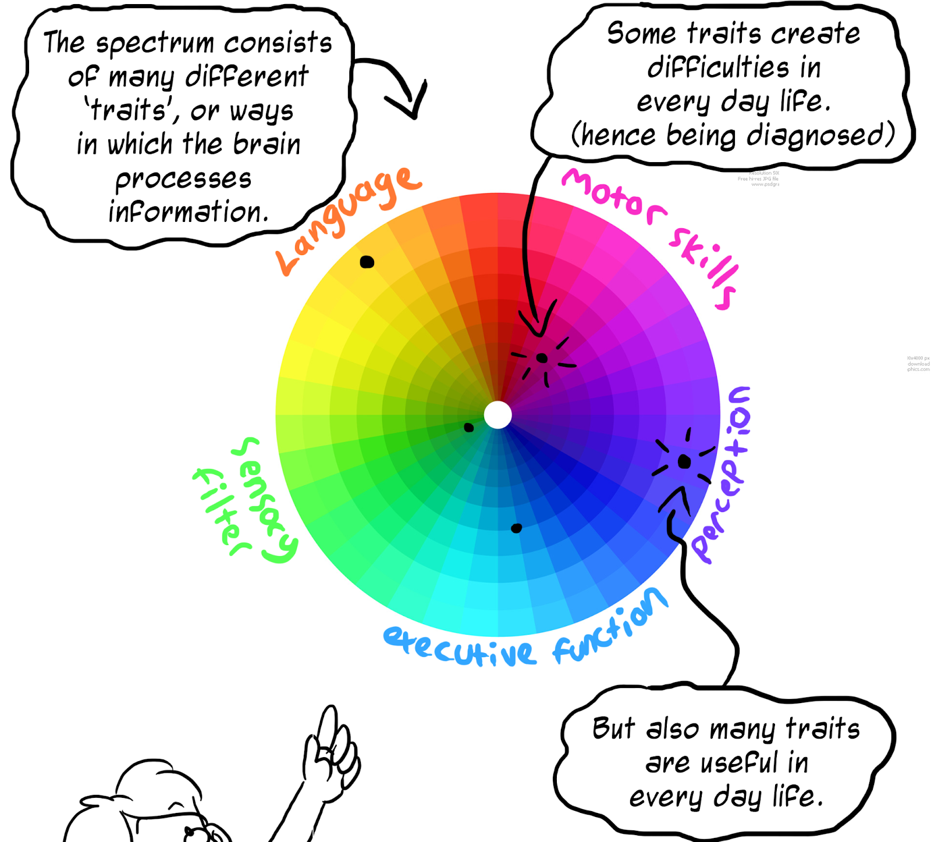
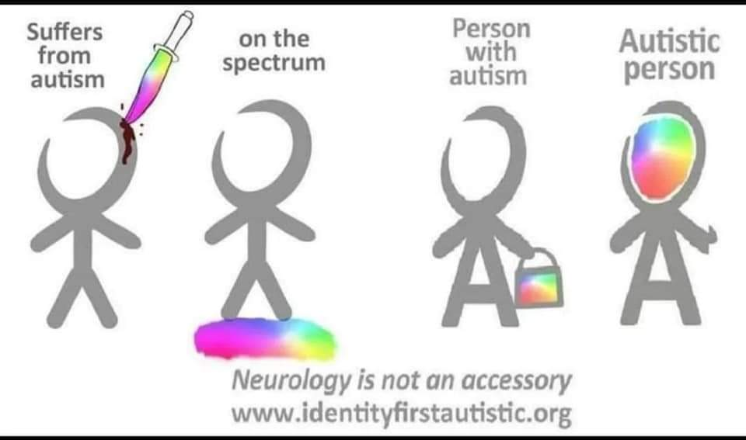
Diagnostic criteria – differences:
social and communication
flexibility, logic and cognition
sensory sensitivity
Source: Understand the Spectrum - www.rebeccaburgess.co.uk

Slide 4
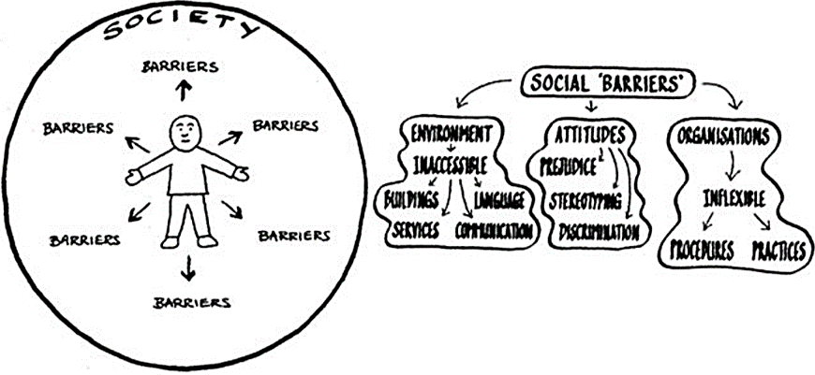
Social model of disability (source: www.neurodivercitysg.com)

Slide 5
Autism is a mental health condition

Slide 6
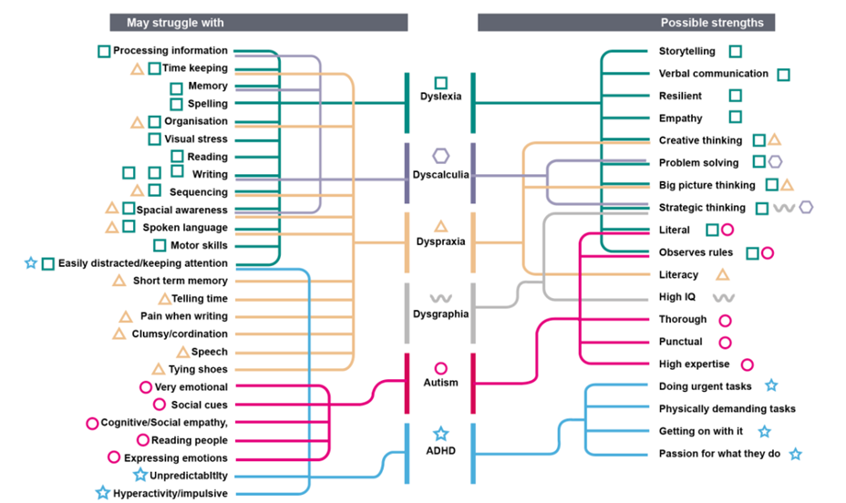
Credit: Ollie Sweetman, HMRC Digital
Neurodiversity mind map - strengths and challenges
Examples of neurominority or neurodivergent conditions and their effects

Slide 7
Autistic people don’t feel empathy

Slide 8
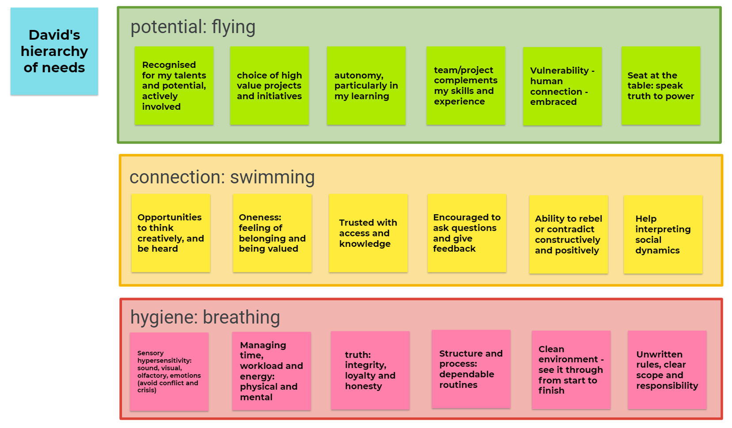

Slide 9
Find out more
Accessibility standards – not optional
GDS autistic persona – user-centred design considerations
Language and identity – neurodiversity explained
David's shielding story: Civil Service blog Aug ‘20
Apolitical blogs from Helen Jeffries: I want to communicate and be understood, but it’s a struggle | A letter from the autistic colleague you didn’t know you had
UN autism awareness day celebration (YouTube) 2 panel discussions on inclusive workplaces for autistic people
MHCLG neurodiversity celebration (Vimeo)

