Slide 1
Communications Strategy
2016/17
Name of author eg – DoC for Dept

Slide 2
Introduction: Organisational purpose and aims
Use this section to layout the role of your organisation and how your comms output delivers value for HMG

Slide 3
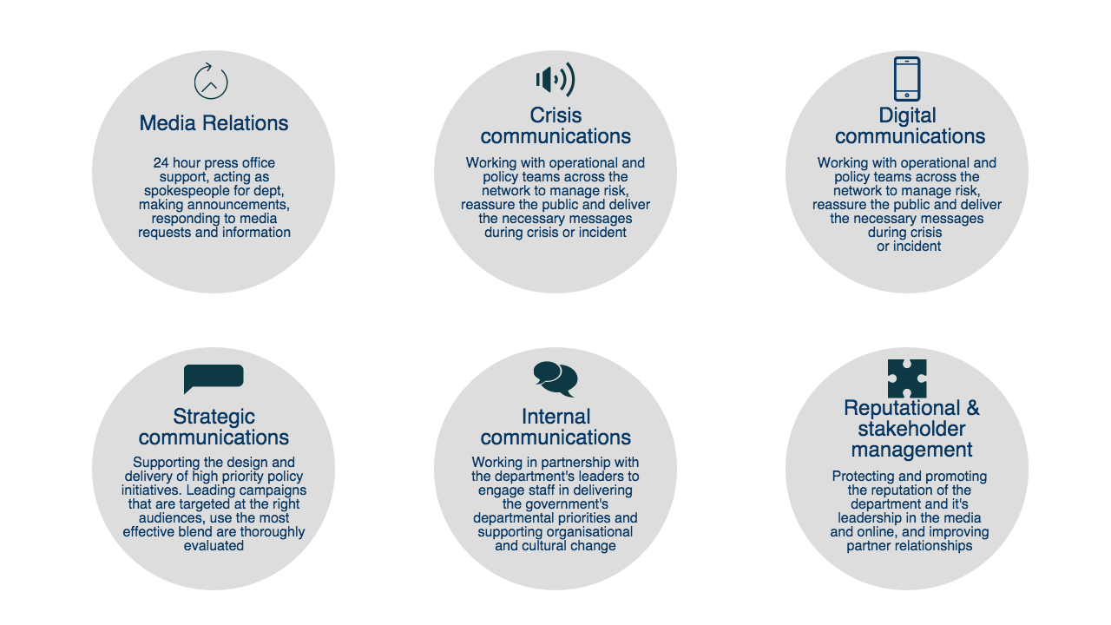
The role of communications in government

Slide 4
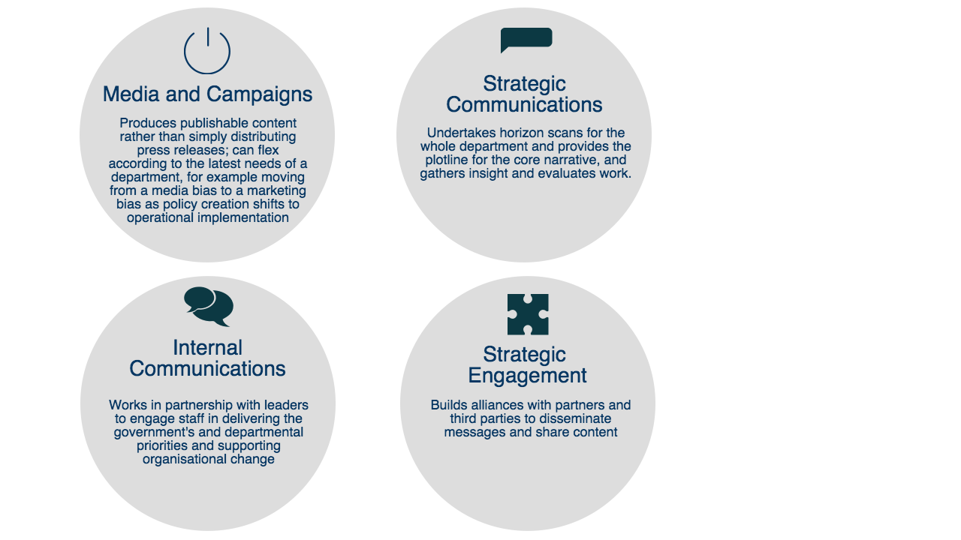
Outline how your are implementing the recommendations from the Modern Communications Operating Model to deliver effective communications
Text here to outline how following this recommendation
Text here to outline how following this recommendation
Text here to outline how following this recommendation
Text here to outline how following this recommendation

Slide 5
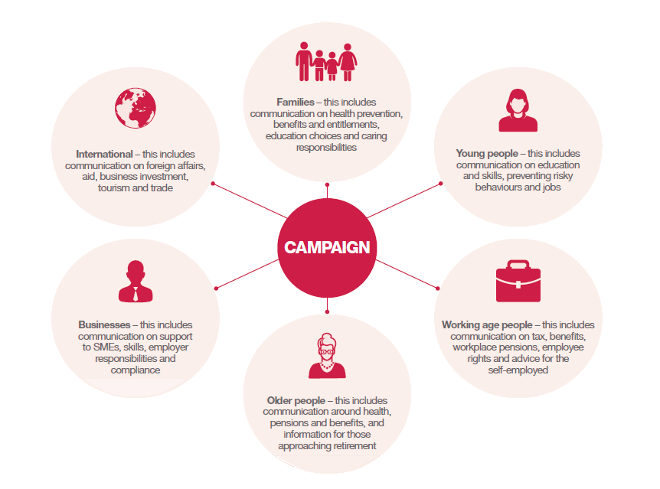
Core audiences: This section outlines the core audiences government campaigns should aim to reach

Slide 6




Core government narrative themes

Slide 7
Government Communications Key Priorities
Use this section to outline your key comms priorities linked to government narrative
Department comms supporting the delivery of organisational and government priorities
Government narrative Main themes | Department Key objectives | Department/ALB-led campaigns and comms activity
Providing Economic Security
Protecting Our National Security
Extending Opportunity
Delivering for Britain

Slide 8
Learning and development: Use this slide to outline learning and development work with comms
The GCS aspiration is to strengthen and unify the profession to deliver world class communications
Use this section to layout progress with L&D last year and how you plan to build on it for next reporting year. Include hours spent, average days spent on L&D
Sharing Knowledge:
Use this section to specify how you will contribute to GCS up-skilling programmes eg, comms exchange, contribute to centralised recruitment
What is the
expectation
for L&D this year?
How will you use the
L&D to track against
The 4 I’s?
Explain how you will
Track progress – on a monthly basis? Send bulletins with training ops?
Break down budget per head and no. of L&D opps
GCS talent programme participation?
Comms team
budget for L&D?

